Slide 1
Collaborating with others
Dr. Domhnall Carlin, QUB

Slide 2
Research code is often…
Single writer
Single user
Written with the above two points in mind
It shouldn’t be.
This leads to technical debt.
Notes:
Should be able to hand code over to masters student, collaborator
- comes back to bite you
- BUS FACTOR OF ONE
- knowledge decays. You come back and even you cant remember it

Slide 3
Research should be…
Used by other people - that’s impact
Developed and collaborated on
Notes:
Should be able to hand code over to masters student, collaborator
- comes back to bite you
- BUS FACTOR OF ONE
- knowledge decays. You come back and even you cant remember it

Slide 4
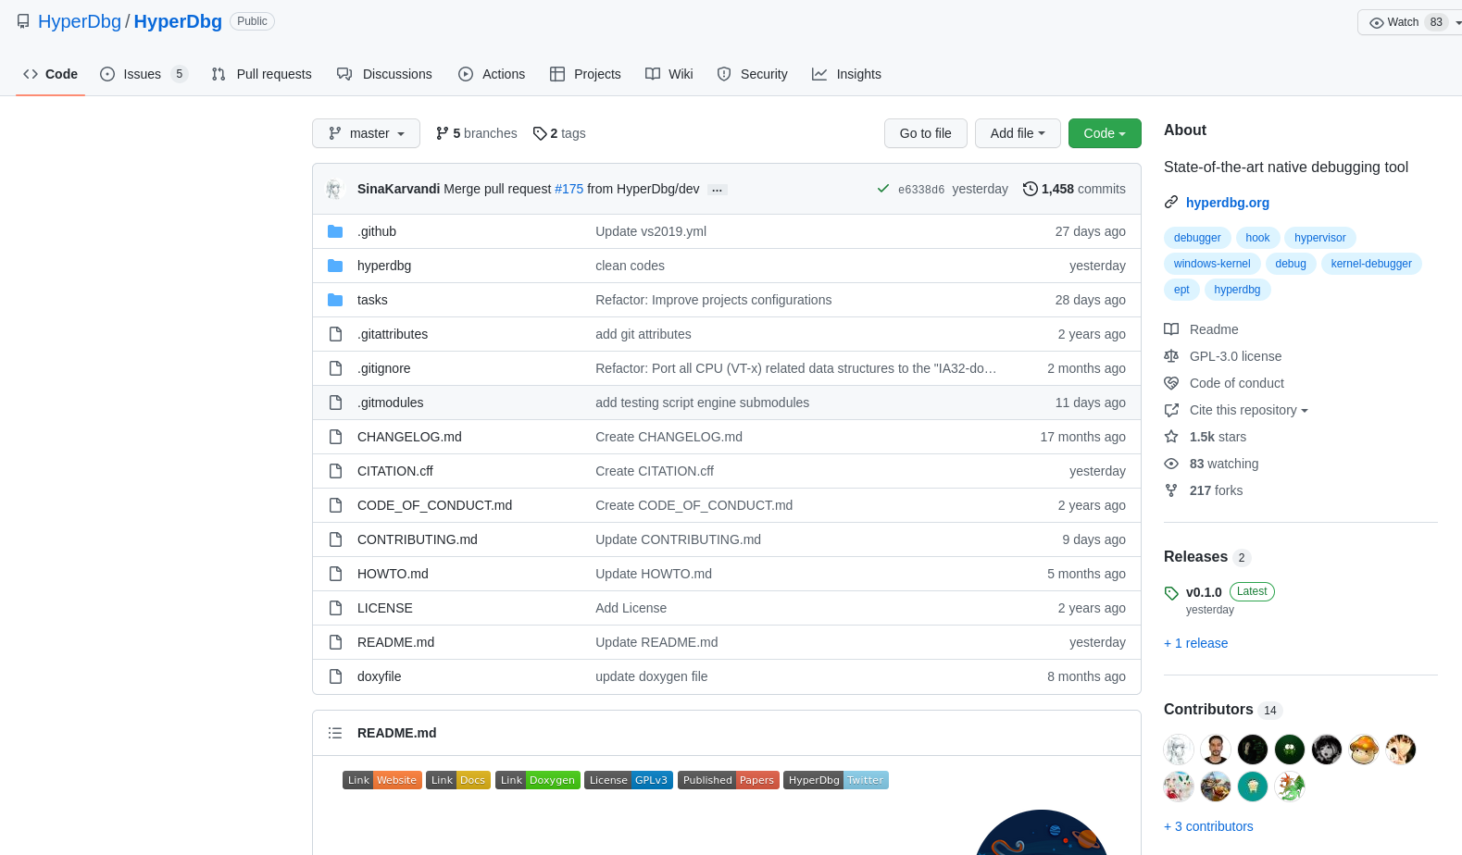
https://github.com/HyperDbg/HyperDbg

Slide 5
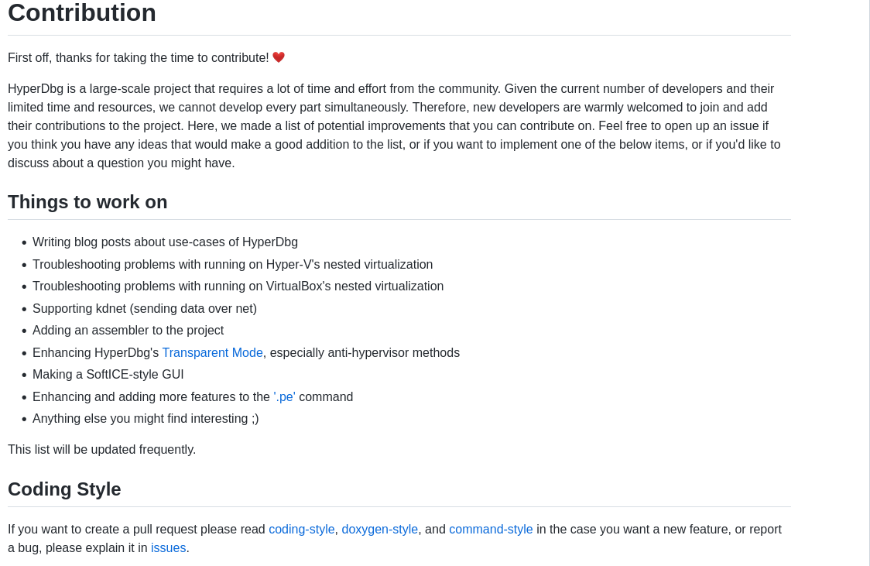

Slide 6
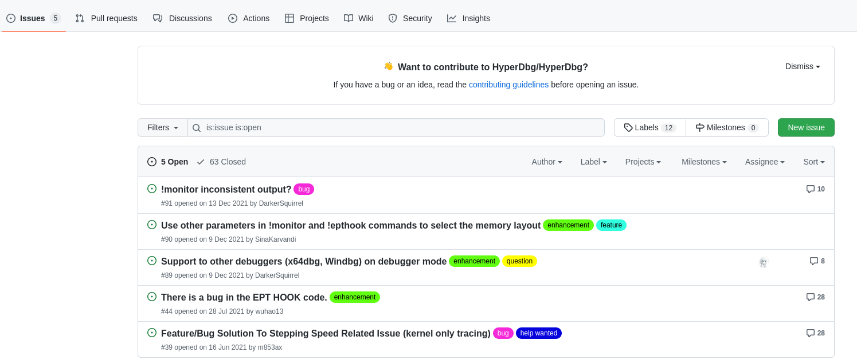

Slide 7
